Slide 1
Hedging Commodity Price Risk: Part A
FRE 501
November 23, 2021

Slide 2
Topics
Long and short positions in the spot market.
Price risk facing those long and short in the spot market.
Textbook example of a short and long hedge.
Introduction to three marketing scenarios (e.g., procurement by a local cooperative, corn exporter, ethanol processor).
Overview of Iowa corn and ethanol data.
Construction of histograms and percentiles for profits earned with each of the three scenarios, with and without hedging.
Measuring hedging effectiveness as a price risk reduction tool.

Slide 3
Long vs Short in the Spot Market
We begin with some definitions
In the spot market:
  Long means you own unpriced commodity. You benefit if the spot price rises and you lose if the spot price falls.
  Short means you borrowed the commodity and immediately sold it – or something equivalent. You must eventually purchase the commodity and repay your loan. You benefit if the spot price falls and lose if the spot price rises.
Examples of a long spot position:
  A farmer who has unsold grain in her storage bins.
  A grain company which provided a deferred delivery contract to a farmer, and has not yet forward sold the grain.

Slide 4
Long vs Short in the Spot Market, Cont’d
Examples of a short spot position:
  Some grain companies allow farmers to deliver unpriced grain and sell it at a later date. The grain company sells the delivered grain and then pays the market price to the farmer when the farmer chooses to sell.
  See the first page of https://www.farmerstradingco.com/images/E0024601/DEFERREDPRICING.pdf?fbclid=IwAR2WIeB2G9LuVY6pr3KDoxtahz6WA9Vzm0qE7qhKODp6Fdevh9SJ9o3G1Tk
  An exporter which forward sells grain to an overseas customers and waits until the shipment date before purchasing the grain to be delivered.
  A local processing plant forward sells the processed commodity and will purchase the raw commodity for crushing at a later date.

Slide 5
Price Risk
Being long in the spot market implies facing the risk of falling prices.
Being short in the spot market implies facing the risk of rising prices.
When margins are tight, an adverse price movement can have severe financial consequences.
Some firms are simultaneously long in the processed spot market (e.g., unpriced soybean oil) and short in the input spot market (e.g., soybeans not yet purchased or forward priced).
These firms must manage their crush margin.

Slide 6
What can be done to reduce risk by those who are long and short in the spot market?
Most farmers will forward sell part of their crop at the time the input costs are sunk to reduce selling price risk.
The forward sale transfers price risk to grain companies – they become long in the spot market when the deferred delivery contract is signed.
Gabi Menhard, a former MFRE alumni/program administer, now works for Lyft Commodities – she brokers deals between grain suppliers and feedlots so that price risk for both sides has largely been eliminated.
A commodity swap contract allows an agri-business to swap a risky income flow for a safe income flow.

Slide 7
Hedging with a futures contract.
For those who are long in the spot market, taking a short position in the futures market for that same commodity will reduce price risk.
For those who are short in the spot market, taking a long position in the futures market for that same commodity will reduce price risk.
If spot and futures prices move together and respond in a similar way to information shocks, then the profit or loss in one market will be largely offset by the loss or profit in the other market.
Hedging effectiveness depends critically on the strength of the co-movement between spot and futures prices.

Slide 8
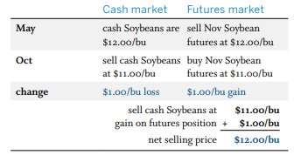
Standard textbook example of a short hedge
http://simpson.ca.uky.edu/files/cme-self_study_guide_to_futures_and_options.pdf

Slide 9
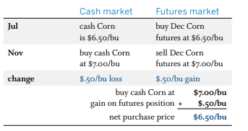
Standard textbook example of a long hedge

Slide 10
Margin Calls
A spot market loss that results from an adverse price movement can be largely offset by a corresponding gain on a futures transaction.
Unfortunately, this also means that a spot market gain that results from a favourable price movement can be largely offset by a corresponding loss on a futures transaction.
To make matters worse, the loss on the futures transaction will typically require sizeable margin calls along the way, and funds may be not available to finance these calls.
The airlines occasionally get hammered by margin calls when the price of fuel falls and their long futures positions lose vast amounts of cash.

Slide 11
Case Study: Corn and Ethanol in Iowa
Our goal is to examine in a real-world setting the degree to which hedging reduces price risk.
The scenario is corn marketing in Iowa for the years 2016 – 2021.
We examine three distinct scenarios:
  A large agricultural cooperative who becomes long in the market by virtue of signing a deferred delivery contract with a local farmer.
  A multinational corn exporter (e.g., ADM) who becomes short in the market by virtue of forward selling corn to a Japanese importer.
  An ethanol plant forward sells distiller dried grains (DDG), which is an ethanol by-product, and in doing so becomes short in the spot market for corn and long in the spot market for ethanol.

Slide 12
Grain Cooperative – Long Spot
The Mid Iowa Cooperative (https://www.midiowacoop.com/grains/cash-bids/ ) offers deferred delivery marketing contracts to local farmers.
In first location in the list is the town of Beaman (population 161 in 2020), with logo “You’re not dreaming,… You’re in Beaman”!
The second row in the table (next slide) shows the cash bids when the contract is signed on November 20, 2021 and delivery is allowed anytime in January of 2022.
The -$0.22/bu basis is added to the Nov 20th $5.77/bu March futures price to get the price paid to farmer, $5.52/bu, when delivery is made.
After the contract is signed the cooperative is long in the spot market.

Slide 13

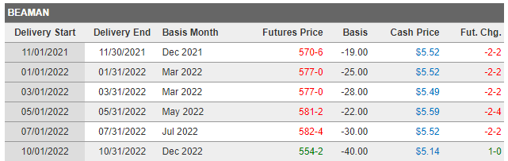
Corn Cash Bid

Slide 14
Forward Export Sales
The next slide shows aggregate export sales of U.S. corn (https://apps.fas.usda.gov/export-sales/complete.htm ) as of November 11, 2021.
Much of the “new sales” for the week of November 11, 2021 are forward sales by firms locking in a sales price -- in the coming weeks these firms will purchase the corn and initiate the delivery process.
The slide after next shows a graph of U.S. corn export bids relative to those of other countries (https://apps.fas.usda.gov/psdonline/circulars/grain.pdf ) (November 20, 2021).
Exporters of U.S. corn must aggressively use forward sales to be competitive.
These forward sales put exporters in a short position in the spot market.

Slide 15
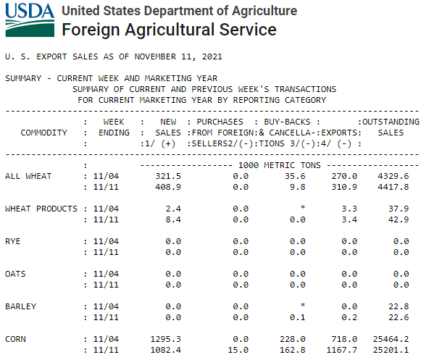

Slide 16
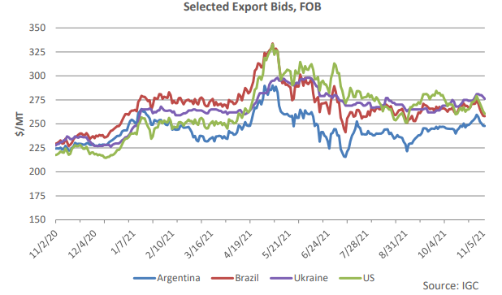

Slide 17
Crush Margin, Iowa Corn
Take some time to learn about the crush margin in the production of ethanol by reading the CME report: https://www.cmegroup.com/trading/agricultural/files/AC-406_DDG_CornCrush_042010.pdf
The CME notes that 1 bushel of corn produces approximately 2.8 gallons of ethanol and 17 pounds of distillers dried grains (DDGs).
If we multiply ethanol’s price of x dollars/gallon by 2.8 gallons/bushel we get ethanol’s cost expressed on a per bushel basis.
If we multiply DDG price of z dollars/ton by (1/2000) tons per pound we get DDG’s price per pound.
Multiply this value by 17 to get DDG’s price per bushel of corn ➔ multiply price of DDG by 17/2000 = 0.0085 to convert to $ per bushel.

Slide 18
Crush Margin Continued
The crush margin is defined as the per bushel revenues from selling ethanol and DDG minus the per bushel cost of buying the corn.
Think of the crush margin as the contribution margin where a contribution is required for other variable inputs (e.g., natural gas, electricity, enzymes and labour), overhead and profits.
The graph on the slide to follow shows how the price of ethanol (top line) is broken down into the net cost of corn (after netting out value of DDG), other operating costs and returns over operating costs.
The horizontal line is an estimate of the capital costs ➔ only when the red shaded area > horizontal line is there positive profits.
https://www.card.iastate.edu/research/biorenewables/tools/hist_eth_gm.aspx

Slide 19
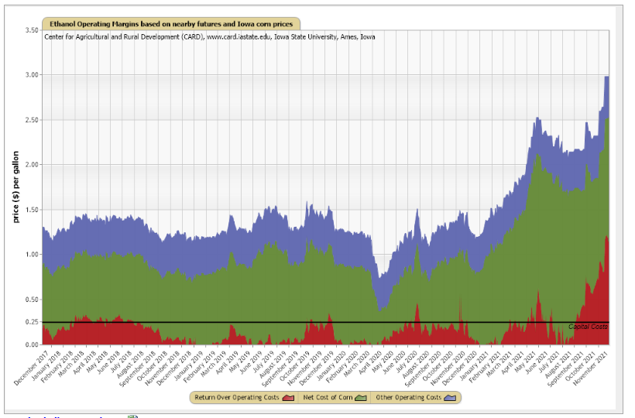

Slide 20
Data for Three Scenarios (Long, Short, Crush)
The weekly data is an aggregate for Iowa, as reported in https://www.extension.iastate.edu/agdm/energy/xls/agmrcethanolplantprices.xlsx
The spot price for corn was derived by adding the Iowa’s corn basis, as reported by the USDA, to the price of the closest CME corn contract.
The spot price of ethanol was derived by adding the Iowa’s ethanol basis, as reported by the USDA, to the price of the closest CME ethanol contract.
The price of DDG are based on feedlot payments.
Of particular interest is the strength of the correlation between raw corn and DDG because both are highly substitutable as a livestock feed.
The correlation between corn and DDG is approximately 0.75, which is relatively strong but still far from reflecting perfect substitutability.

Slide 21
Iowa Mid Cooperative: Deferred Delivery Contract
Long Spot Position
Short Hedge

Slide 22
Cooperative – Long in the Spot Market
In this first scenario, the cooperative locks in a forward buy price with the farmer.
When the farmer delivers the corn in a months time, the cooperative sells it at the current market spot price.
The graph to follow shows the weekly average spot price of corn in Iowa.
Choose an arbitrary week to serve as the forward contracting period.
Now choose a second arbitrary period 4 – 6 weeks ahead.
The price in the latter period minus the price in the former period is equal to the profits earned by the cooperative on the transaction.

Slide 23
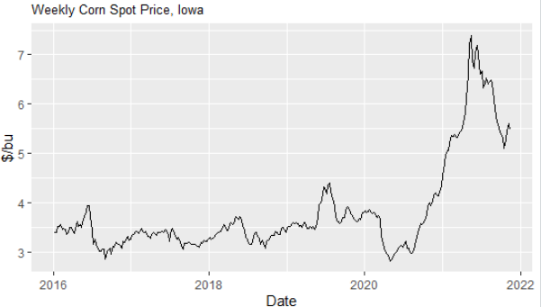

Slide 24
Sub Dividing the Weekly Data
The weekly data is divided into five groups:
  December, January, February ➔ March Contract Group
  March, April ➔ May Contract Group
  May, June ➔ July Contract Group
  July, August ➔ September Contract Group
  September, October, November ➔ December Contract Group
This sub division ensures that when we later examine hedging scenarios, the forward contract and delivery of the commodity take place when the basis is calculated with one contract only.
For example, a forward purchase in mid December and delivery in early February take place when the basis is calculated with the March contract.

Slide 25
Simulating the Buy and Sell Prices
The cooperative is assumed to sign the forward purchase contract on date X and take delivery/sell the corn in the spot market on date Y.
R is used to randomly select dates X and Y within each of the five subdivisions and for each of the six years (2016 – 2021).
The average difference between X and Y is about 4 weeks (specifically, 4.75 weeks for the March and December subdivisions, and 3.4 weeks for the May, July and the September subdivisions).
Profits for the cooperative is the spot price on date Y minus the spot price on date X.
Profits were simulated 100 times for each of the 30 subdivisions.
What follows is a histogram of the 3000 simulated profits.

Slide 26
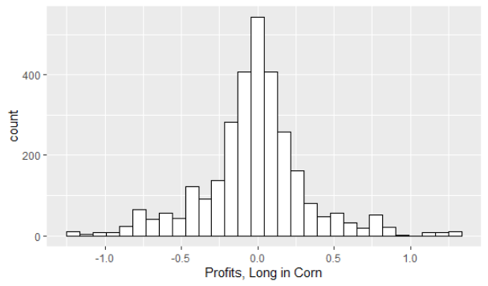
($/bu)

Slide 27
Price Risk
Price risk facing the cooperative who is long in the Iowa corn spot market for an average duration of about 4 weeks is reflected by the left tail of the histogram.
The following percentiles quantify this price risk:
5% 10% 20% 30% 40% 50%
-0.66 -0.43 -0.22 -0.12 -0.06 -0.02
5% probability the cooperative will lose more than $0.66/bu.
10% probability the cooperative will lose between $0.22 and $0.43/bu
The cooperative earns ≈ 0 on average but there is sizeable price risk.

Slide 28
Short Hedge
To hedge against falling prices the cooperative should:
  Take a short position when deferred delivery contract is signed.
  Offset the short position when the farmer delivers the commodity and the cooperative sells it in the spot market.
Losses on the spot market transaction are partially offset by gains in the futures market and vice versa.
The same simulation procedure is used to generate 3000 occurrences of combined spot market and future market profit outcomes.
The next slide shows the histogram of these profit outcomes.

Slide 29
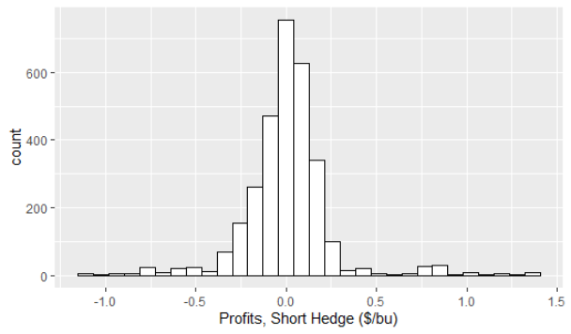

Slide 30
Short Hedge Lowers Price Risk
The histogram has much thinner tails with the short hedge as compared to the long spot position.
The thinning of the left tail implies significantly lower risk.
A comparison of the percentiles quantifies the difference in risk.
The short hedge appears to have reduced the price risk for the cooperative by about 50 percent.
 | 5% | 10% | 20% | 30% | 40% | 50%
Long Spot | -$0.66/bu | -$0.43/bu | -$0.22/bu | -$0.12/bu | -$0.06/bu | -$0.02/bu
Short Hedge | -$0.32/bu | -$0.23/bu | -$0.12/bu | -$0.06/bu | -$0.02/bu | -$0.008/bu

Slide 31
Change in the Basis
Recall that the basis is the spot price minus the futures price.
Last lecture we learned that the basis trends up over time (e.g., becomes less negative) as the futures contract approaches expiry.
We know that the basis also changes in response to regional supply and demand shocks.
Thus, the basis is stochastically trending up.
Of interest is the change in the basis over the hedging period.
Basis_Change = Basis when Commodity is Delivered/Sold and Short Hedge Lifted – Basis when Deferred Delivery Contract Signed and Short Hedge Initiated.

Slide 32
Simulating the Change in the Basis
We can simulate the change in the basis in the same way we simulated the 3000 profit occurrences for the long spot or short hedge positions.
The next slide shows the histogram.
The histogram is identical to the histogram for the profits earned with a short hedge.
This means that measuring the change in the basis is an alternative way to measure the profit outcome for the short hedger.
This relationship will be examined in detail in the next lecture.

Slide 33
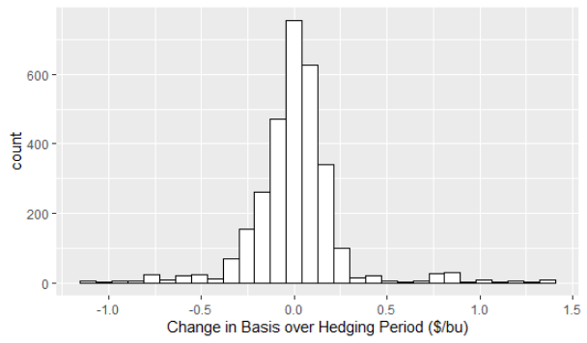

Slide 34
Exporter Forward Sale Contract
Short Spot Position
Long Hedge

Slide 35
Mirror Image of Long Spot/Short Hedge
There is no need to repeat the previous steps because this case is the mirror image of the previous case.
The spot and futures prices are the same as in the previous case but they enter the profit function with the opposite sign.
A long hedge consists of taking a long position when the forward sales contract is signed, and offsetting this position when corn is purchased/delivered and the long position is offset.
profits earned by grain exporter when short in the spot market =
- (profits earned by the cooperative when long in the spot market)
And
profits earned by grain exporter with long hedge =
- (profits earned by the cooperative with short hedge)

Slide 36
Profits for long hedger =
- (change in the basis)
Price risk is reflected by right tail.

Slide 37
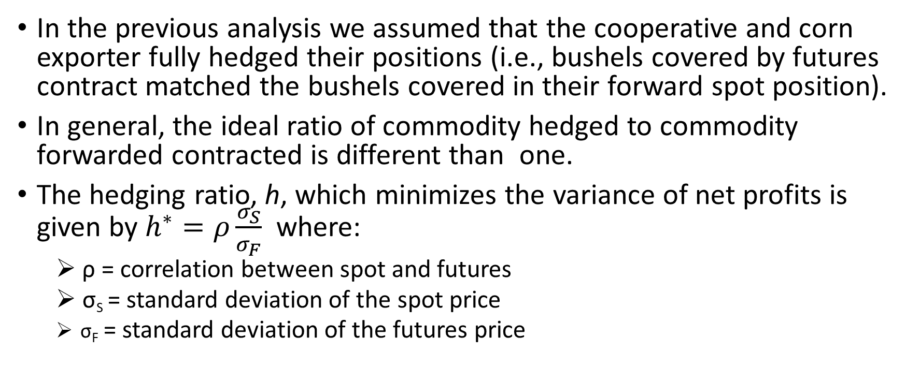
Optimal Hedging Ratio
In the previous analysis we assumed that the cooperative and corn exporter fully hedged their positions (i.e., bushels covered by futures contract matched the bushels covered in their forward spot position).
In general, the ideal ratio of commodity hedged to commodity forwarded contracted is different than one.
The hedging ratio, h, which minimizes the variance of net profits is given by $h^{∗}=ρ\frac{σ_{S}}{σ_{F}}$ where:
  ρ = correlation between spot and futures
  σ_{S} = standard deviation of the spot price
  σ_{F} = standard deviation of the futures price

Slide 38
High Correlation but Different Std Dev
With the current data, the log of the weekly spot and futures price have a correlation of 0.977.
The standard deviation of the log of the spot price, 0.212, is higher than the standard deviation of the log of the futures price, 0.180.
Thus, the optimal hedge ratio is therefore 0.977*(0.212/0.180) = 1.151.
This means that more aggressive hedging (i.e., h > 1) is required to compensate for the sustained fluctuations in the basis.
The figure on the next page uses a hypothetical example to demonstrate that the basis can vary widely over time even if the spot and futures prices are perfectly correlated.

Slide 39
Correlation (ρ) between spot and futures: = 1
Standard Deviation is higher for spot than for futures.
This combination causes the basis to fluctuate over time ➔ uncertainty in hedger profits ➔ optimal hedge ratio (h*) > 1.

Slide 40
Ethanol Crusher
Unhedged Crush
Hedged Crush

Slide 41
Unhedged Crush
The specific assumptions are as follows:
  Processor forward sells distillers dried grains (DDG) to a feedlot at date 1.
  Processor purchases corn in the spot market at date 2.
  Processor produces ethanol and sells it in the spot market at date 3.
Without a hedge, at date 1 the processor is short in the corn spot market and long in the ethanol spot market.
It was noted previously that crush profits ($/bu) can be expressed as
  π_{Crush} = 0.0085*P_{DDG} + 2.8*P_{Ethan} – P_{Corn} where:
P_{DDG} = Price of DDG in $/ton, P_{Ethan} = Price of Ethanol in $/gallon and P_{Corn} = Price of Corn in $/bu.

Slide 42
Hedging the Crush Margin
At date 1 the manager of the ethanol processor forward sells DDG to a feedlot and would like to lock in the current-period crush margin.
She worries that corn prices will be higher when corn is purchased at date 2, and ethanol prices will be lower when ethanol is sold at date 3.
The manager hedges at date 1 by taking a long position in the corn market and a short position in the ethanol market.
When the corn is purchased at date 2, the long corn hedge is offset.
When the ethanol is sold at date 3, the short ethanol hedge is offset.

Slide 43
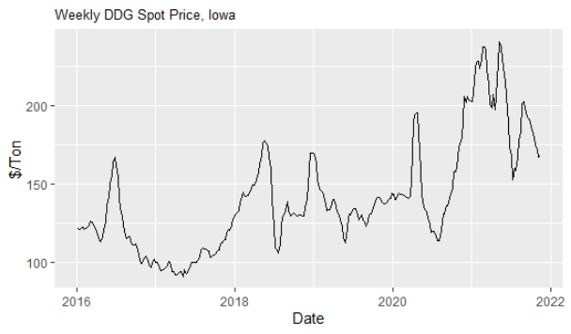
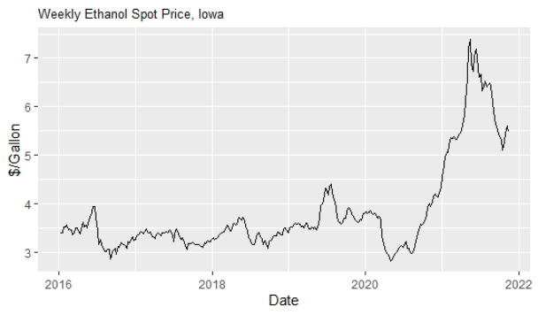
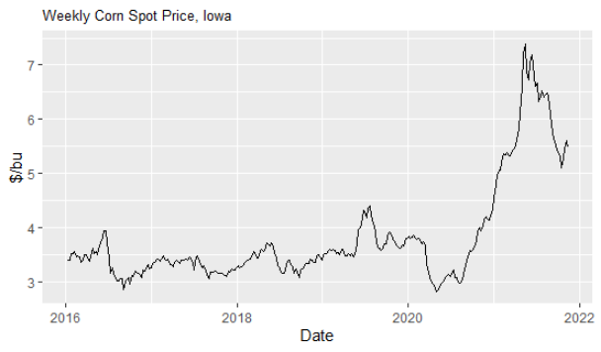

Slide 44
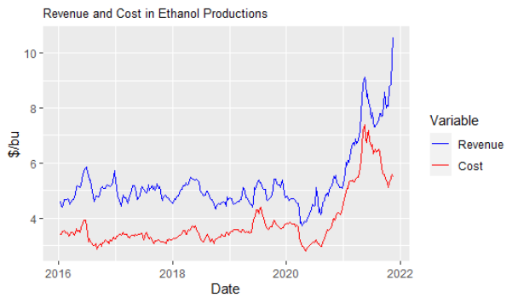
Mean Crush Margin = $1.50/bu
Revenue = Sale of ethanol and DDG. Cost = Purchase of Corn.
Gap is the crush margin if all pricing is on the same day.

Slide 45
Crush Margin Simulations
In this case three rather than two dates are chosen for each of the 30 data subcategories (see previous description of dates for the details).
The prices at the three dates are used to calculate the unhedged or hedged crush margin.
The process is repeated 100 times which means we will have a 30*100 = 3000 unhedged and hedged crush margin outcomes.
Of interest is the deviation in the crush margin calculated with prices in three periods from the crush margin which existed at date 1 (i.e., the target crush margin).
A histogram of the 3000 crush margin deviations is presented on the next slide.

Slide 46
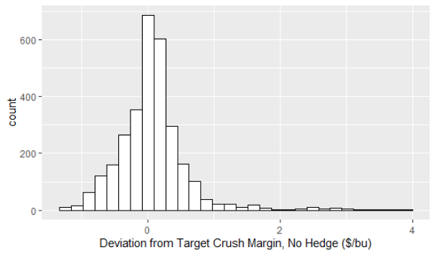
Deviations in the actual crush margin from the target crush margin lie mostly within the [-1, 1] range.

Slide 47
No Hedge Percentiles
The percentiles for the no hedge crush margin case are as follows:
There is a 5% chance the crush margin will fall more than $0.69/bu below the target crush margin.
There is a 10% chance the crush margin deviation below the target crush margin will be between $0.50/bu and $0.29/bu.
There is a 30% chance the crush margin will be at least $0.115/bu below the target crush margin.

Slide 48
Hedging the Crush Margin
The histogram to follow is the same as the previous histogram except now the deviation from the target crush margin is the combination of profits earned in the spot market and earnings in the futures market.
Specifically, a long corn position is taken at date 1 and lifted at date 2. As well, a short position is taken at date 1 and lifted at date 3.

Slide 49
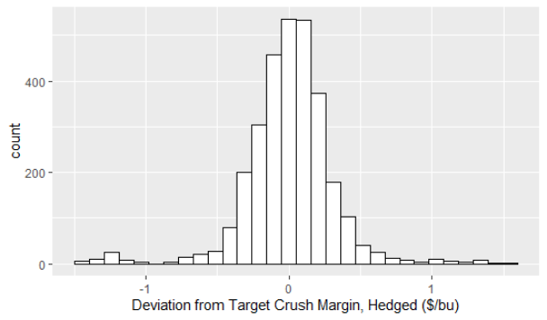
The left tail of this hedged crush margin histogram is pulled in somewhat relative to the no-hedge case ➔ moderate level of price risk protection.

Slide 50
Comparison of Hedge and no Hedge Percentiles
 | 5% | 10% | 20% | 30% | 40% | 50%
Crush No Hedge | -$0.70/bu | -$0.50/bu | -$0.29/bu | -$0.11/bu | -$0.03/bu | -$0.04/bu
Crush Hedged | -$0.41/bu | -$0.30/bu | -$0.19/bu | -$0.11/bu | -$0.04/bu | -$0.02/bu
The hedge was successful in pulling in the left tail of the distribution of profits by a moderate amount.
Price risk is reduced by a little less than one half ➔ less price risk protection in this case as compared to the long and short spot positions.

Slide 51
Reason for Poor Crush Margin Hedging Performance
The concern is that corn prices will increase and ethanol prices will decrease after the DDG is sold in date 1; i.e., the crush margin will shrink.
This is similar to the calendar spread (midterm exam question): the speculator does not care how absolute prices change, only how the contract price spread (e.g., Dec 21 and Mar 22) changes.
In this case, risk is reduced if the date 1 futures position becomes more profitable with a narrower spread ➔ offset spot market losses.
  Long corn and short ethanol at date 1 ➔ joint position becomes more profitable as spread narrows.

Slide 52
Poor Hedging Performance, Cont’d
The variation in the crush margin around its target value is strongly related to how the difference in the ethanol basis and the corn basis changes over the hedging period.
The variation in the difference between the corn and ethanol basis over time is larger than the change in either of the individual basis over time.
Thus, the variation in the crush margin is relatively large, even when fully hedged.
This important result will be revisited next lecture.

Slide 53
Summary and Conclusions
The goal of this module was to empirically examine hedging outcomes with little attention to the underlying theory.
Next lecture a more formal theory of hedging will be introduced and illustrated with the eight-quarter pricing model.
When textbooks provide examples of hedging the scenarios usually depict highly successful price risk reductions.
As this lecture demonstrates, hedging in the real world is often moderately effective at best.
After accounting for trading costs and margin calls, some firms choose not to hedge and instead use other methods of price risk management.

